Slide 1
Epidemiology, Public Health

Slide 2
Health & Medicine in 2 broad genre
Personal Health
Public Health, Policy & Epidemiology
While individual health is very important Public Policy, Public Health and Epidemiology play a critical role in nation building and its impact
on society and on an individual. It also determines choices made in food, sanitation, social behaviour, law etc

Slide 3
Earlier a lot of choices used to be made by intuition and national level eg: Rice procurement destroying millets and leading to spread of diabetes.
Some influence of customs/religion/habits etc were also ingrained
Lack of data/ proper tools were a good reason
Today Big Data and Machine Learning can help us make certain choices

Slide 4
Infant Mortality Rate
IMR is the number of deaths per 1000 live births of children
IMR is around 9 in Kollam in Kerala some districts in UP are as high as 70 .Indian average is 45!!
What are the Casual factors?
Institutional delivery
Vaccination
PHC’s
Use of Big Data to reduce deaths
Pentavalent vaccine project of INCLEN

Slide 5
Maternal Mortality Rate
It is the rate of deaths of women from pregnancy/child birth complications for 100000 live births
Lowest in Kerala and highest in Assam 50 to 250 almost 5 times
Casual factors include
Age of mother at Child birth
Nutrition for the mother
Sanitation
Institutional factors
The Tamil Nadu experiment

Slide 6
Life Expectancy
Ife span on an average
Depends on nutrition
Depends on life style
On income levels
On education
……

Slide 7
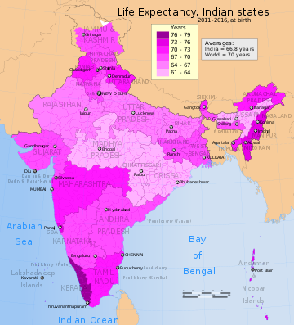

Slide 8
Whole of Society Approach
While those metrics are key they cannot be seen in isolation
Nutrition contributes to healthy bodies
Agriculture and allied activities to nutrition
Per capita income to life style
Financial inclusion to per capita income
Education to jobs
……..

Slide 9
Nutrition
How do weidentify nutritional needs for better living?
How do we popularize health food habits?
How do we make them available?
….

Slide 10
Education
How do we ensure basic level of education for all?
How do we encourage girls to get educated?
How do we ensure that helth education is disseminated?
…………..

Slide 11
Per Capita Income
How does per capita income affect lifestyles and critical care?
How does that affect use of public health resources?
…..

Slide 12
Financial Inclusion
Do people have access to money for healthcare?-Pygmy schemes
Digital inclusion
Insurance
POP scheme in Andhra……

Slide 13
Mathematical models for policy planning
It does not appear that the IMF is fully utilizing modern data science languages, tools, frameworks, and integrated development environments such as R, R Studio, Python, NumPy, Anaconda, SQL, Hadoop, Spark, or MongoDB. According to IMF job listings, research assistants are expected to collaborate with economists using Microsoft Excel, in addition to other traditional econometric analysis software tools. These are comprised of established software languages and dashboards for forecasting and simulations such as TSP, Eviews, AREMOS, and RATS.

Slide 14
Many of these programs are several decades old. TSP was first conceived in the 1960’s and was last updated in 2009. Windows-based Eviews is popular, versatile, robust, well-supported, and updated often by its developers. But it was originally introduced in 1965. AREMOS is considered by many as old-hat; its heyday was mostly in the 1980s. RATS specializes in time-series analysis and it has grown into a more powerful program, but it dates back to the halcyon days of Fortran.

Slide 15
The World Bank’s economic forecast, the 2017 Global Economic Prospects, also uses country-specific models, but the Bank relies on vector autoregressions (VARs), which are time-series econometric models familiar to economists. These regressions utilize Cholesky ordering, meaning that exogenous variables are placed in the model in a decreasing order of exogenity. In other words, the World Bank is appropriately taking into consideration “outside the model” risks such as “global financial market uncertainty;” “domestic financial market or political uncertainty;” “short-term interest rates;” and other hazards. Many forecasters were criticized during the 2008-2009 financial crisis for not including these “Black Swan” risks into their models.

